Slide 1

MAJOR PROJECT DESIGN REVIEW
TITLE : BEHAVIOR-DRIVEN CUSTOMER SEGMENTATION AND CHURN PREDICTION USING HYBRID CLUSTERING AND EXPLAINABLE AI
DEPARTMENT OF COMPUTER SCIENCE AND ENGINEERING
Project Guide
Dr. N. Srinivas
Associate Professor
Team Members (22IMD02)
R. Avinash Reddy - 22P61A05K1
Tanishq Verma - 22P61A05N3
T. Keerthana - 22P61A05N4

Slide 2

OUTLINE
Abstract
Introduction
Existing system
Proposed system
Problem statement
Objective
Advantages of Proposed System
Requirements & Specification
Project Time Plan
Literature Survey
References
Diagrams

Slide 3
ABSTRACT
We will develop a hybrid system for customer segmentation and churn prediction by integrating RFM modeling with advanced clustering techniques and supervised learning models.
We will incorporate SHAP-based Explainable AI to ensure transparency and interpretability in both the segmentation and churn prediction processes.
We will design and deploy an interactive dashboard that provides visual insights, churn probabilities, and actionable business strategies for improved decision-making and customer retention.
Keywords : Customer Segmentation, Churn Prediction, RFM Modeling, Hybrid Clustering, Explainable AI-SHAP, Business Intelligence, Machine Learning.

Slide 4

INTRODUCTION
We aim to analyze customer behavior patterns to enhance satisfaction, retention, and targeted marketing strategies.
Existing manual or rule-based techniques often fail to detect subtle behavioral trends, resulting in less effective business decisions.
Through machine learning, we will perform accurate customer segmentation and churn prediction by analyzing large-scale transactional data.
By integrating SHAP-based Explainable AI and an interactive dashboard, the system will provide transparent insights, identify high-risk customers early, and support strategic planning across diverse industries.

Slide 5

EXISTING SYSTEM
1. The existing systems rely heavily on manual categorization and simple rule-based methods, which fail to capture complex customer behavioral patterns.
2. They often use a single clustering technique and lack integration of RFM modeling or churn prediction, leading to incomplete customer insights.
3. Most existing models provide little to no interpretability and rely on static reports, making it difficult for businesses to trust and act on the results.
4. Feature selection and hyperparameter tuning are typically performed manually or with minimal automation, resulting in lower accuracy and inefficient performance.

Slide 6
PROPOSED SYSTEM
The proposed system focuses on automating customer segmentation and churn prediction.
It collects and preprocesses customer transaction and demographic data, handling missing values and normalizing attributes for accurate analysis.
RFM (Recency, Frequency, Monetary) modeling is applied to derive meaningful behavioral metrics that capture customer engagement and spending patterns.
A hybrid clustering approach is implemented using K-Means, Gaussian Mixture Models (GMM), and DBSCAN to identify diverse and behavior-driven customer segments.
Supervised learning models such as XGBoost and Logistic Regression are used for churn prediction, helping businesses identify and retain at-risk customers.

Slide 7

PROBLEM STATEMENT
Develop a scalable and interpretable system that uses hybrid clustering, churn prediction, and Explainable AI to accurately segment customers, predict churn, and provide actionable business insights.

Slide 8

OBJECTIVE
To build a hybrid intelligent system that accurately segments customers and predicts churn using RFM analysis, advanced clustering, supervised learning, and Explainable AI to support transparent, data-driven retention decisions.

Slide 9

ADVANTAGES OF PROPOSED SYSTEM OVER EXISTING SYSTEM
Provides highly accurate customer segmentation by combining multiple clustering techniques, ensuring deeper insights into behavioral patterns.
Integrates churn prediction models to proactively identify high-risk customers, enabling timely retention strategies.
Utilizes RFM modeling for behavior-driven analysis, allowing businesses to design precise and targeted marketing campaigns.
Incorporates SHAP-based Explainable AI, ensuring transparency and trust in segmentation and prediction results.
Offers dynamic, real-time interactive dashboards, helping businesses visualize insights and take immediate action.

Slide 10

REQUIREMENTS & SPECIFICATION
SOFTWARE REQUIREMENTS:
Operating System : Windows, Linux (Ubuntu/CentOS), or macOS.
Programming Languages : Python.
Libraries and Frameworks : NumPy, Pandas, Scikit-learn, Seaborn,
Matplotlib, XGBoost, SHAP, Streamlit.
IDE : PyCharm / Visual Studio Code.
Other Tools : Git (for version control),
Docker (optional for deployment).
DataBase (Optional) : SQLite or CSV file storage.
HARDWARE REQUIREMENTS:
Processor (CPU): Multi-core processor (Intel i5/i7 or AMD equivalent).
RAM: Minimum 8GB (16GB recommended for large datasets).
Storage: Minimum 250GB free disk space.
GPU (optional): Mid-range GPU for faster model training.
Network: Stable internet connection for dataset access and dashboard deployment.

Slide 11
PROJECT TIME PLAN
SNO | DURATION | TASK
 | 09.01.2025 to 11.01.2025 | Submission of abstract
2. | 20.01.2025 to 25.01.2025 | Abstract presentation
3. | 27.01.2025 to 02.02.2025 | Literature survey
4. | --- | --
5. | --- | --
6. | --- | --
7. | 31.03.2025 | Submission of Publication document
8. | 07.04.2025 | Submission of Final Project Document

Slide 12

LITERATURE SURVEY
SNO | TITLE | AUTHOR | YEAR | ALGORITHM USED | ADVANTAGES | LIMITATIONS
1 | A Big Data-Driven Hybrid Model for Enhancing Streaming Service Customer Retention Through Churn Prediction Integrated With Explainable AI | Usman Gani Joy et al. | 2023 | LSTM-GRU, LightGBM , SHAP, EBM | Hybrid deep learning + ML, SHAP/EBM for transparency. | Focused on streaming, not RFM; data access not specified
2 | Prediction of Customer Behavior Changing via a Hybrid Approach | Nien-Ting Lee et al. | 2023 | Statistical models, ML, Clustering | Dynamic churn, behavior-based segmentation, less data needed | RFM not explicit, limited to two datasets

Slide 13
LITERATURE SURVEY
SNO | TITLE | AUTHOR | YEAR | ALGORITHM USED | ADVANTAGES | LIMITATIONS
3 | Customer churn prediction system: a machine learning approach | P. Lalwani et al. | 2021 | LR, NB, SVM, RF, DT, XGBoost, AdaBoost | Ensemble models, high accuracy, robust validation | No clustering or RFM, limited explainability
4 | Hybrid black-box classification for customer churn prediction with segmented interpretability analysis | Arno De Caigny et al. | 2024 | Hybrid segmented models, SHAP | Model-agnostic XAI, segmented insights, strong benchmarking | RFM not explicit, complex implementation

Slide 14
LITERATURE SURVEY
SNO | TITLE | AUTHOR | YEAR | ALGORITHM USED | ADVANTAGES | LIMITATIONS
5 | Exploiting time-varying RFM measures for customer churn prediction with deep neural networks | Gary Mena et al. | 2023 | RNN, Transformer, Hybrid DNN | RFM with DNN, sequential modeling, strong results | Hybrid models not always better than DNN alone
6 | Customer churn prediction in telecom using machine learning in big data platform | A. Ahmad et al. | 2019 | DT, RF, GBM, XGBoost, SNA | Big data, SNA features, high AUC (93.3%) | No RFM, limited explainability

Slide 15
LITERATURE SURVEY
SNO | TITLE | AUTHOR | YEAR | ALGORITHM USED | ADVANTAGES | LIMITATIONS
7 | A Review on Machine Learning Methods for Customer Churn Prediction and Recommendations for Business Practitioners | Awais Manzoor et al. | 2023 | Review (ML, DL, XAI) | Comprehensive, covers XAI, segmentation | No experiments, review only
8 | Hybrid CNN-LSTM Approach for Predicting and Analyzing Customer Churn in the Banking Sector | Amit Kaushik et al. | 2025 | CNN-LSTM, Clustering | Hybrid DL, segmentation, high accuracy | No RFM, no XAI

Slide 16
LITERATURE SURVEY
SNO | TITLE | AUTHOR | YEAR | ALGORITHM USED | ADVANTAGES | LIMITATIONS
9 | Hybrid Models Using Unsupervised Clustering for Prediction of Customer Churn | I. Bose, X. Chen | 2009 | Clustering, Decision Trees, Boosting | Hybrid clustering, interpretable rules | No RFM, no XAI
10 | Artificial Intelligence Based Customer Churn Prediction Model for Business Markets | J. Faritha Banu et al. | 2022 | CSSO-FS, Fuzzy Rule, QPSO | Hybrid AI, high accuracy | No RFM, limited XAI

Slide 17

REFERENCES
[1]. Kaur, A., & Sarmadi, M. (2024). Adaptive feature selection for imbalanced datasets in customer analytics.
arXiv preprint arXiv:2402.14980.
[2]. Tschalzev, A., et al. (2024). A Data-Centric Perspective on Evaluating Customer Churn Prediction Models.
arXiv preprint arXiv:2407.02112.
[3]. Turali, M. Y., et al. (2024). Enhancing Model Performance through Adaptive Hyperparameter Tuning for
Business Applications. IEEE Transactions on Knowledge and Data Engineering.
[4]. Bolón-Canedo, V., et al. (2023). Recent advancements in feature selection for machine learning models.
Knowledge-Based Systems, 245, 108678.
[5]. Chen, T., & Guestrin, C. (2023). Tree Boosting with XGBoost: Enhancing Predictive Modeling in
Customer Retention. Proceedings of the 23rd ACM SIGKDD International Conference.
[6]. Bergstra, J., & Bengio, Y. (2023). Random search for hyper-parameter optimization. Journal of Machine
Learning Research, 14, 281–305.
[7]. Ibrahimi, E., et al. (2023). Overview of data preprocessing for machine learning applications in customer
behavior analysis. Frontiers in Artificial Intelligence.
[8]. Aggarwal, C. C. (2022). Machine Learning for Business Analytics. Springer.

Slide 18
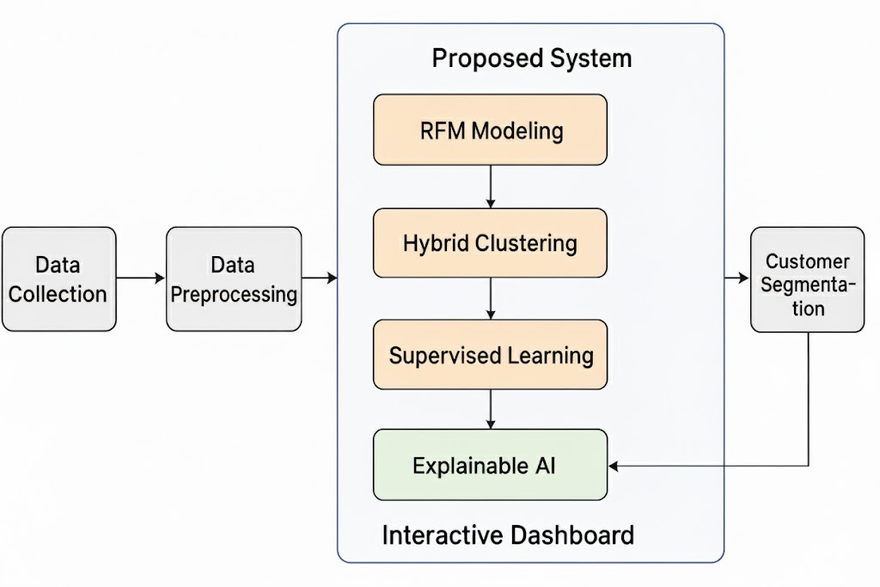
SYSTEM ARCHITECTURE

Slide 19
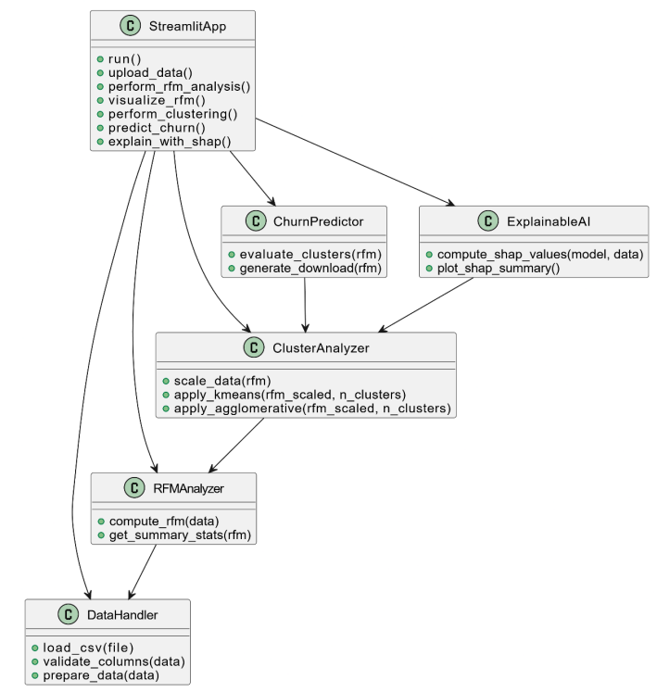
CLASS DIAGRAM

Slide 20
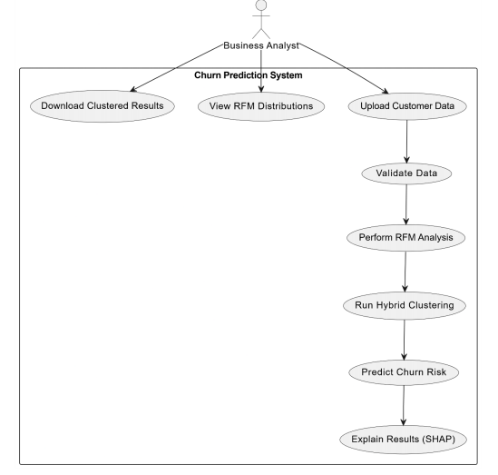
USE CASE DIAGRAM

Slide 21
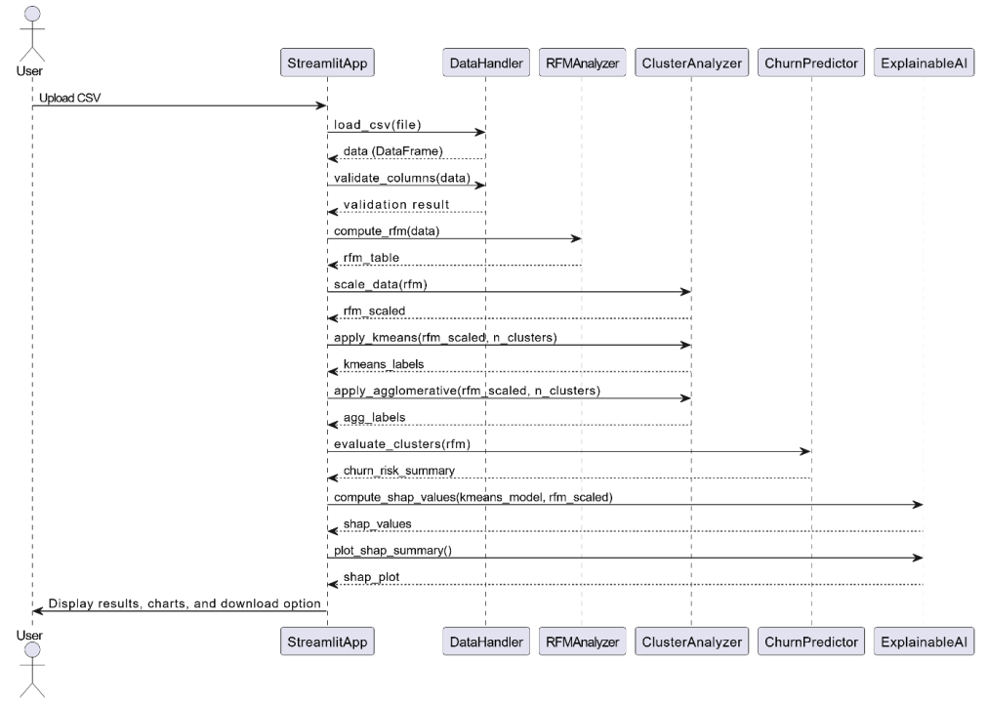
SEQUENCE DIAGRAM

Slide 22
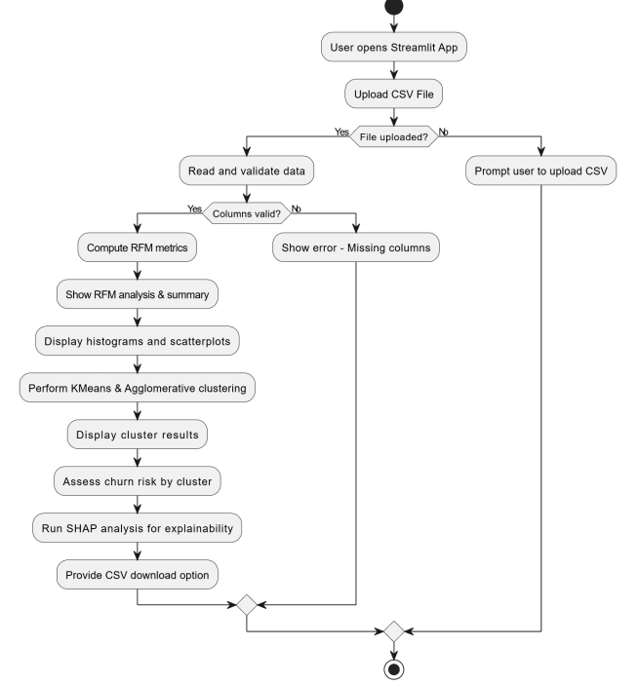
ACTIVITY DIAGRAM

Slide 23
Queries?

